Slide 1
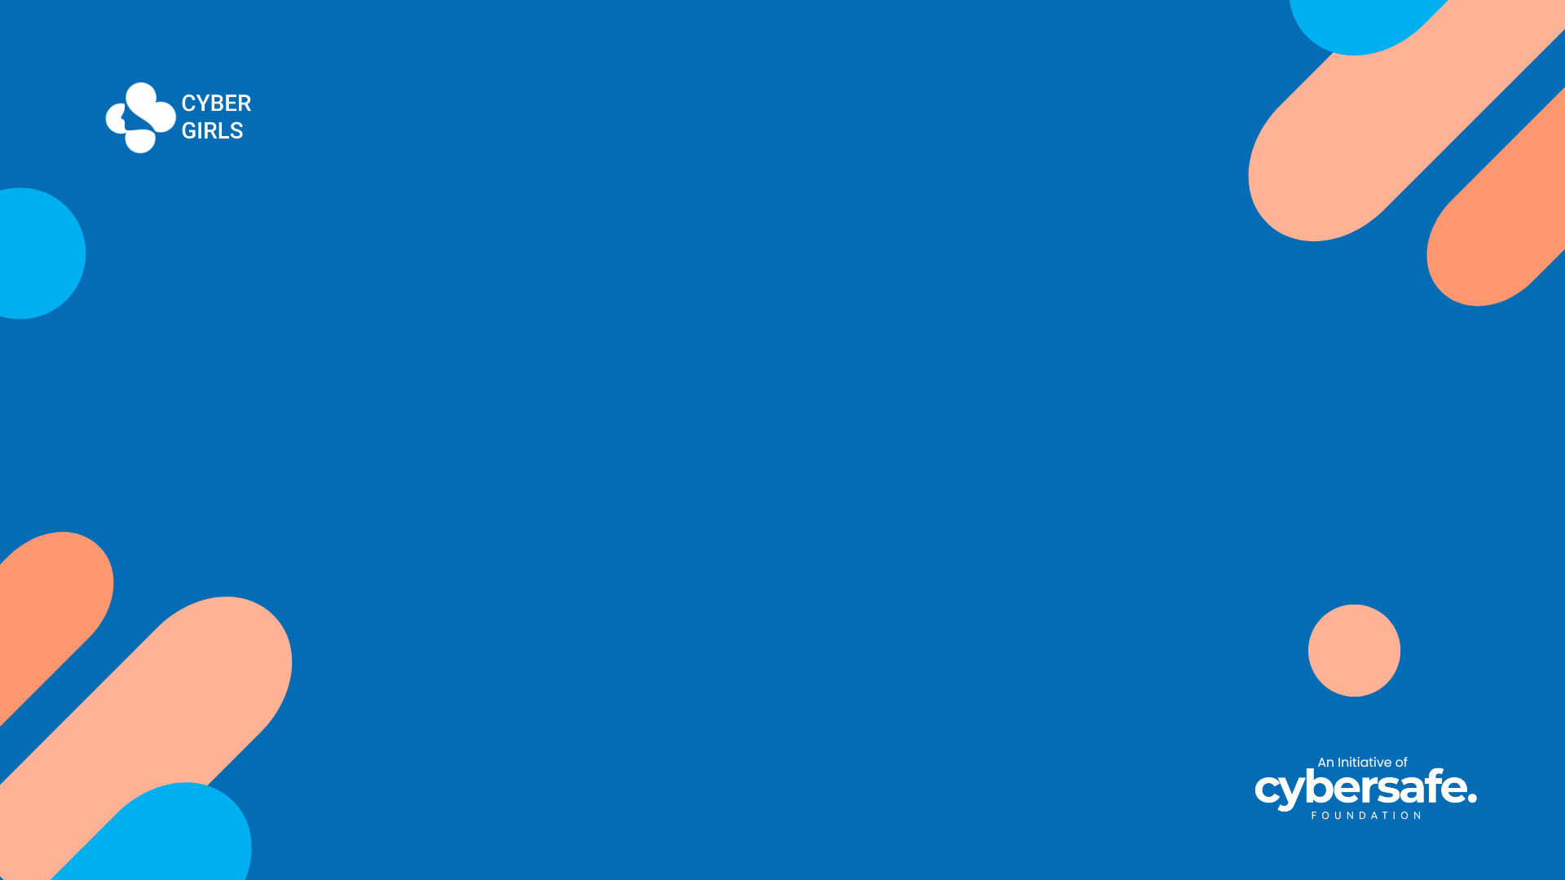

CYBER GIRLS 4 . 0 OPEN DAY PROJECT
Project Title:
Incident Response for
Healthcare Organizations
NAMES:
Chianu-Okoli Chinemerem CG/24/0618 3. Rashida Yakubu CG/24/0700
2. Kate Amarachukwu Igwilo CG/24/0135 4. Gamuchirai Muchafa CG/24/0608
5. Omote Oboakpororo CG/24/0725

Slide 2


Group Number 5
Aim:
Creating an Incident Framework for Healthcare Organization
Objective:
Protecting Patient Data and Complying with Healthcare Regulations
Date: 15th August 2024

Slide 3


Outline
Introduction to Incident Response
Need for Incident Response in Healthcare
Risk Assessment in the Healthcare Sector
Introduction to Incident Response Frameworks
Overview of the SANS Framework
Overview of Healthcare regulation: HIPAA
Incident Response playbook
Case study: Ransomware threat
Conclusion
Questions

Slide 4



Introduction to Incident Response
Incidence response as defined by TechTarget is “an organized, strategic approach to detecting and managing cyberattacks in ways that minimize damage, recovery time, and total costs”.
It is the process by which an organization handles cyber-attacks.

Slide 5
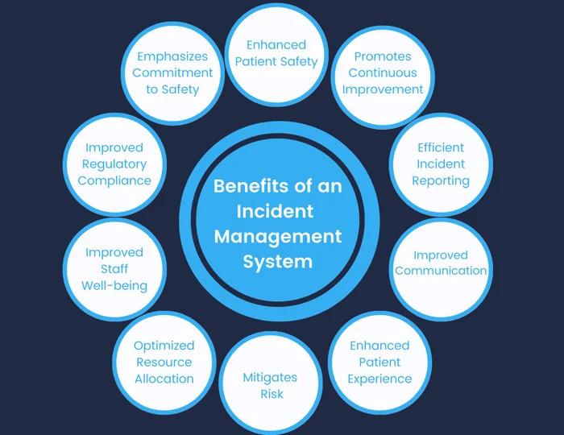
Incident Response in Healthcare
Healthcare organizations are prime targets for cyberattacks due to their critical systems and valuable, unchangeable medical data. This makes them vulnerable to long-term exposure to cybercrime, as healthcare data fetch high prices on the dark web.

Slide 6

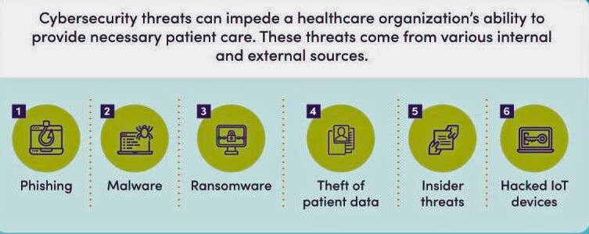
Risk Assessment in the Healthcare Sector
6 Common Types of Security in HealthCare

Slide 7
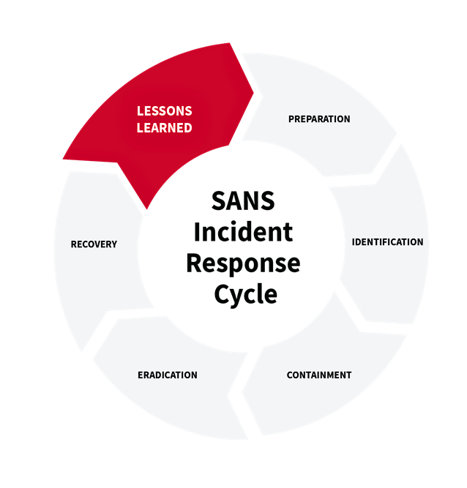
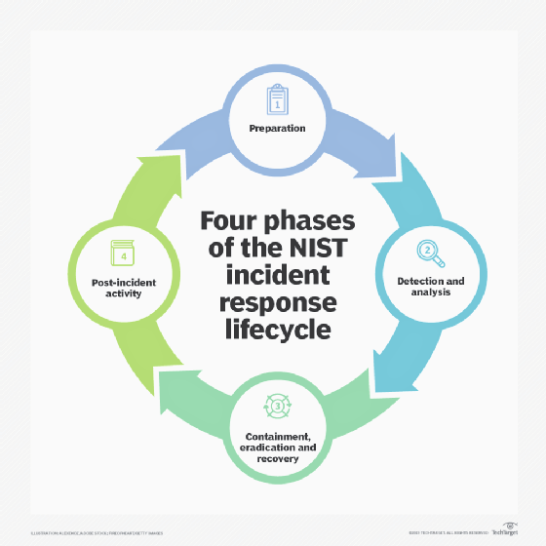
Incident Response Frameworks
VS

Slide 8

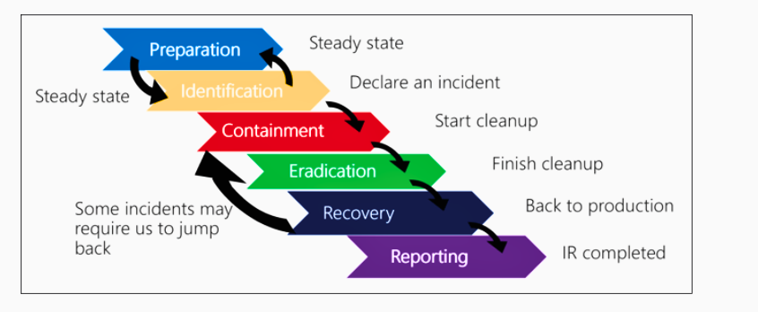
SANS Incident Response Framework

Slide 9
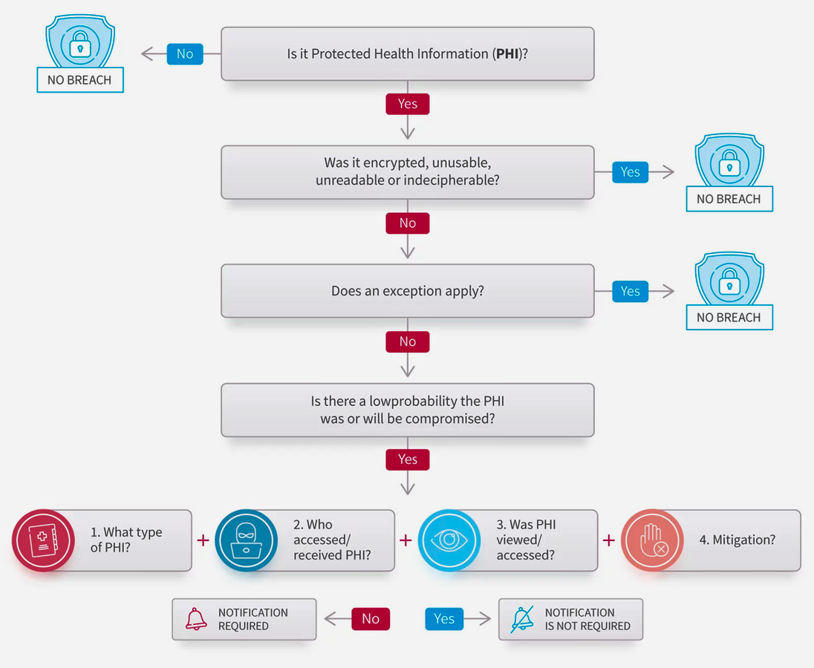
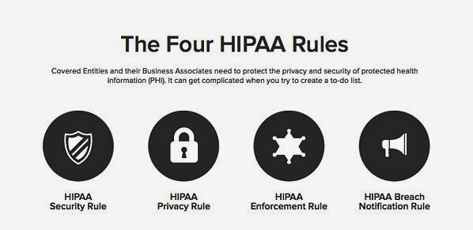
Overview of HIPAA regulatory compliance
HIPAA: Requires safeguards to protect electronic protected health information (ePHI) and ensure data integrity, confidentiality, and availability.

Slide 10
CASE STUDY: RANSOMWARE ATTACK ON ST THOMAS HOSPITAL
Background:
St. Thomas Hospital, a prominent healthcare facility in Accra, encountered a severe ransomware attack. Early on a Monday, an employee reported an inability to access critical hospital data. Upon investigation, the IT department uncovered that external attackers had encrypted sensitive data and observed unusual network activity. The attackers demanded a significant ransom, threatening to publicly release the data and maintain the encryption unless their demands were met.
Objective: Protecting patient data and ensuring strict adherence to HIPAA regulations and internal hospital policies.
Focus: Develop an Incident Response Framework tailored for St. Thomas Hospital.
Framework: Implementing the SANS Incident Response Framework, which includes the phases of Preparation, Identification, Containment, Eradication, Recovery, and Lessons Learned.
Payment made: 20 Millions Dollars worth of Bitcoins

Slide 11
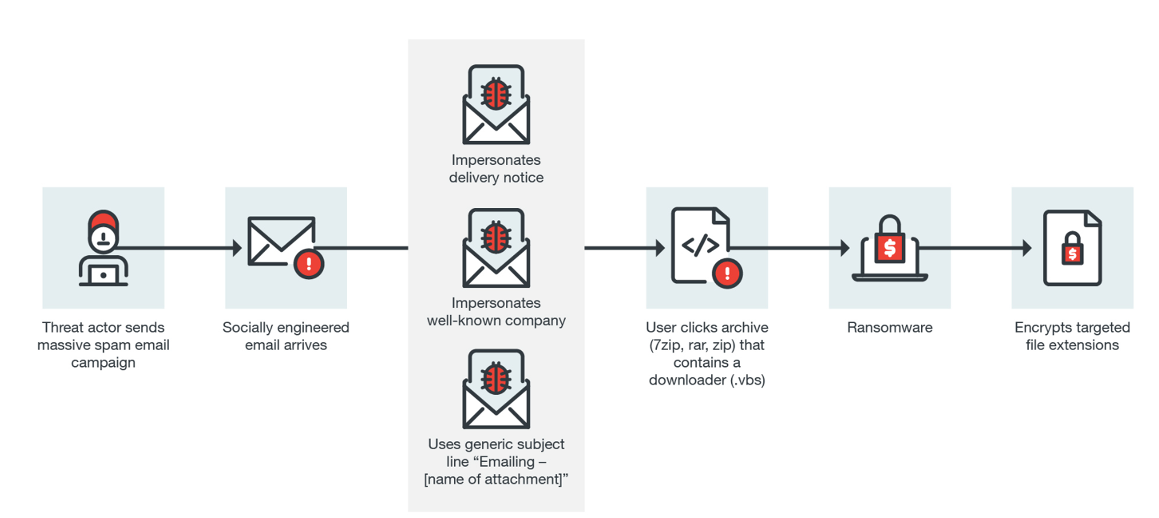
Ransomeware Attack Flow

Slide 12

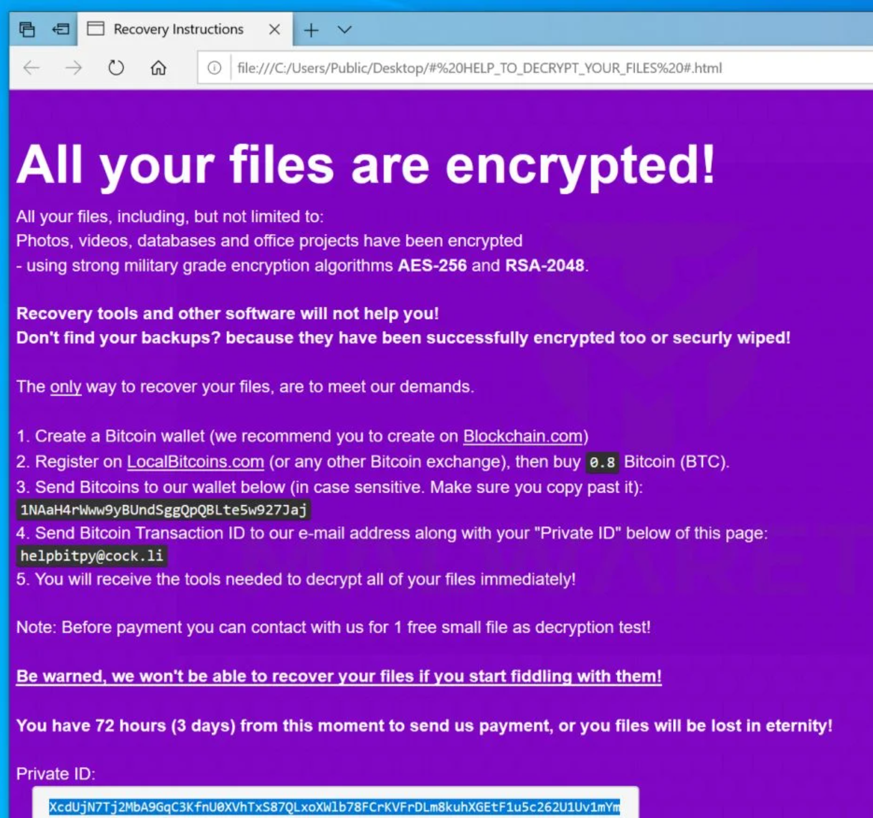
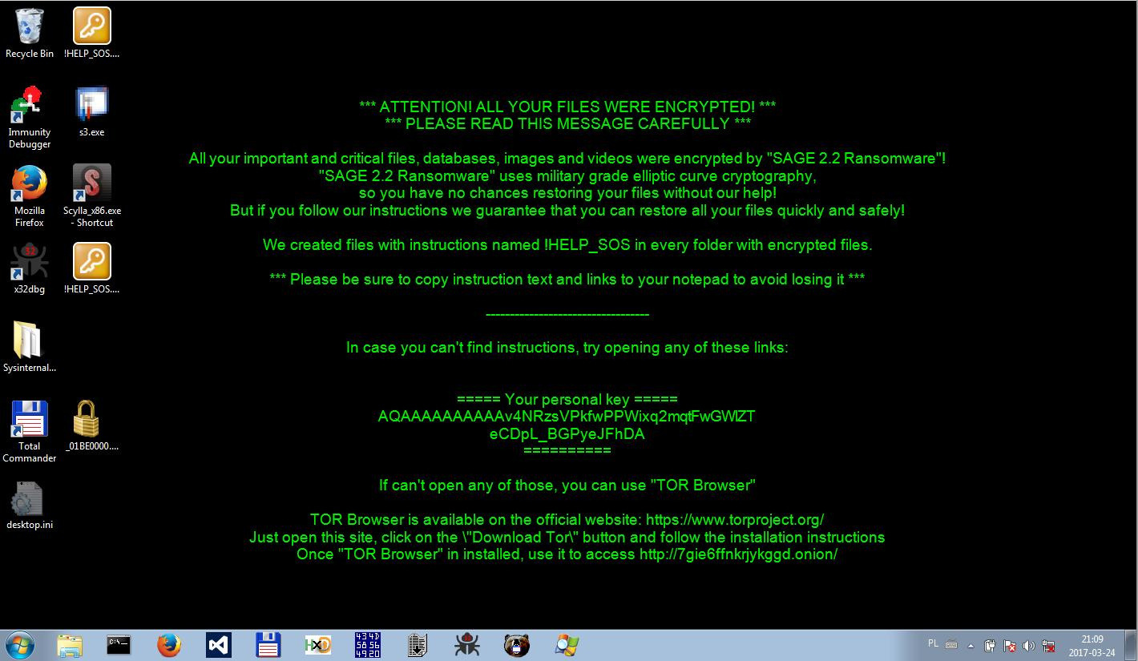
Ransomware.txt File on all Folders

Slide 13
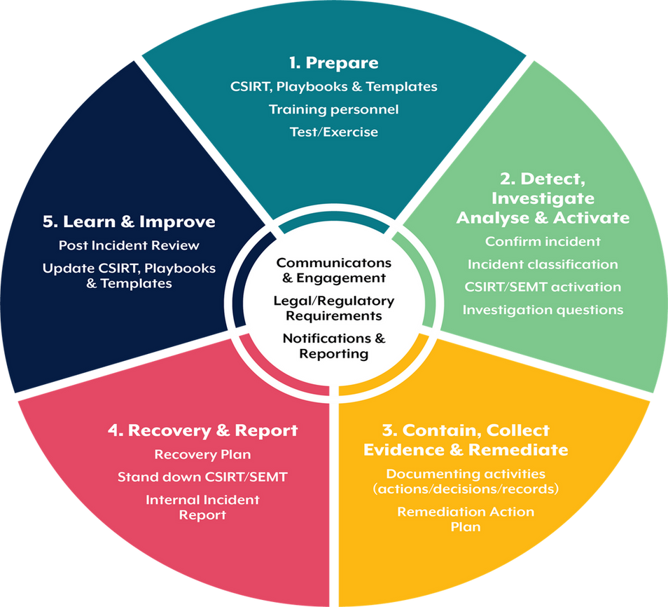
Incident Response Stages for
St Thomas Hospital
Develop processes and procedures for incident response which will avoid critical steps being missed during the incident.
Stakeholders should be known and informed and their roles should be identified.
Prepare a communication plan for effective incident response.
The SANS Response phases:
Preparation: preparing to get ready to handle the incident
Identification: detect the incident
Containment: limiting the impact of the incident
Eradication: removing the threat
Recovery: recover to operational stage
Lesson learned: document and improve the process.

Slide 14

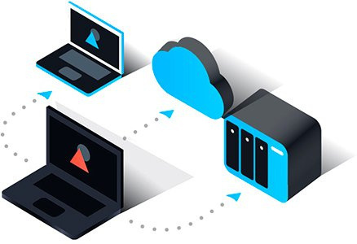
Preparation
Objective: Ensure systems are ready to prevent and respond to ransomware attacks
Steps:
Securely back up critical patient data regularly.
Take an inventory of assets in the healthcare center
Prepare internal and external communication plan
User Training: Train staff to recognize and respond to phishing and ransomware threats.
Assets & Patch Management: Regularly update all systems and software to patch vulnerabilities.
Implement antivirus, endpoint detection, and network monitoring tools.
Tools:
Backup Software: Veeam, Acronis
Training Platforms:KnowBe4, Cofense
Patch Management: ManageEngine, Automox
EDR Tools: Carbon Black
HIPAA Regulation: Requires regular data backups and disaster recovery plans.

Slide 15

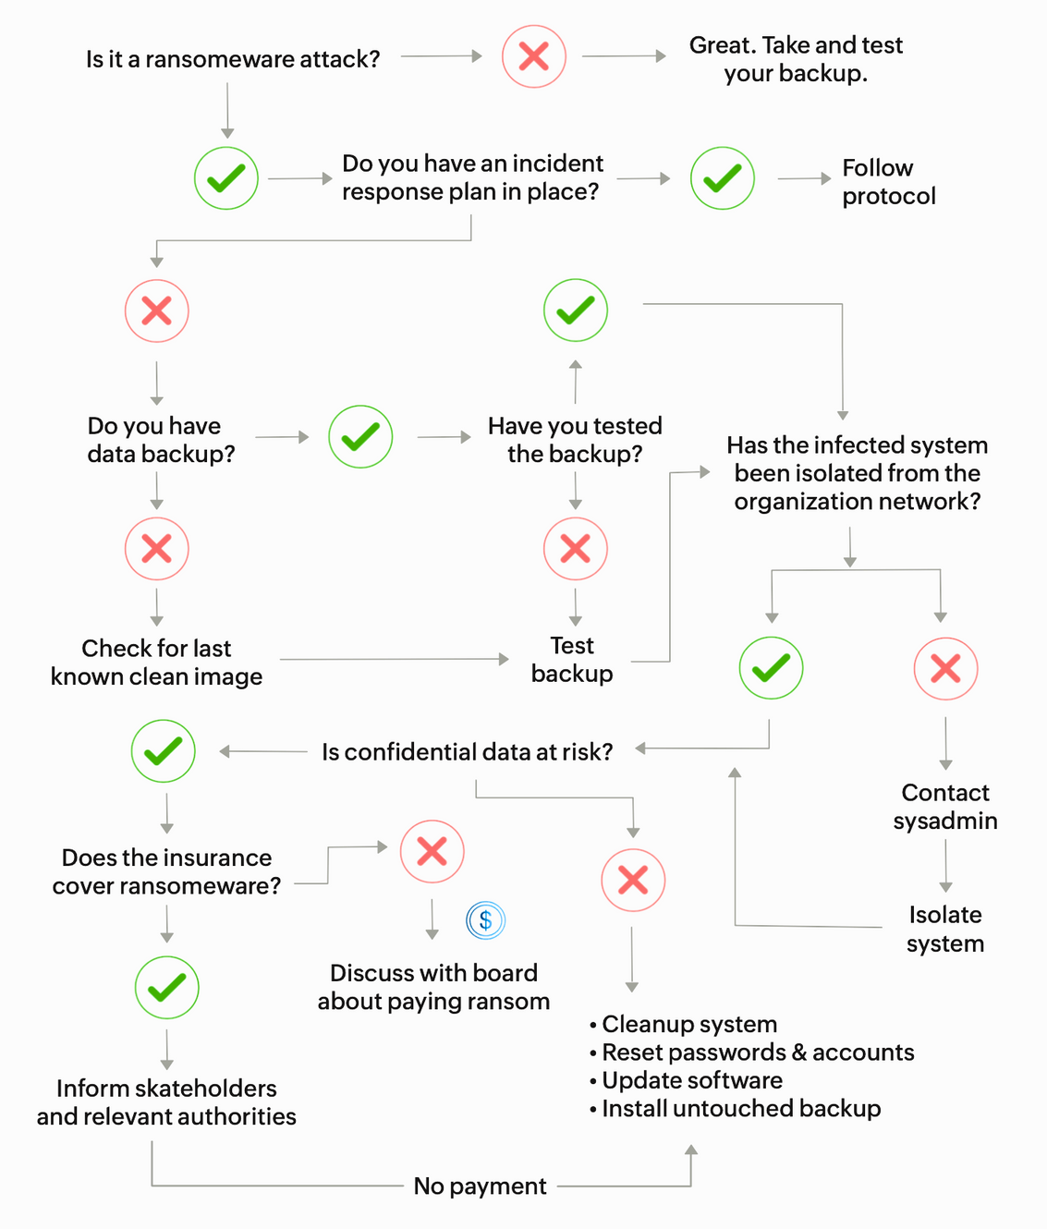
Incident Response Playbook

Slide 16

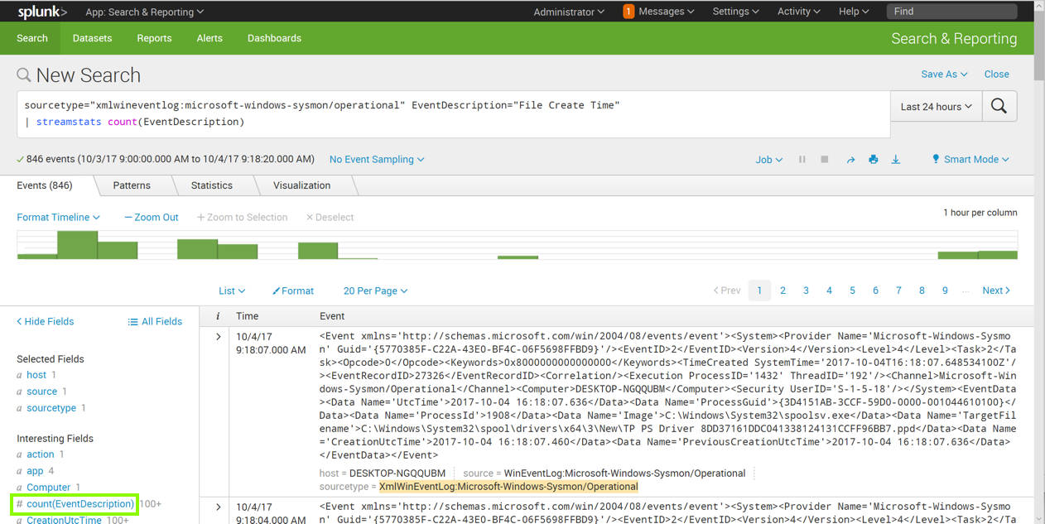
2. Idenitification
Objective: Detect and confirm ransomware infections early
Steps:
Continuously monitor for signs of ransomware, such as unusual file encryption activities.
Alert Mechanisms: Set up automated alerts for suspicious activities
Tools:
SIEM: Splunk, LogRhythm
Network Monitoring Tools: Files are encrypted, SolarWind, IDS, Firewalls Log, IPS,
HIPAA Regulation (11.4): Requirements covers entities to implement monitoring mechanisms.

Slide 17
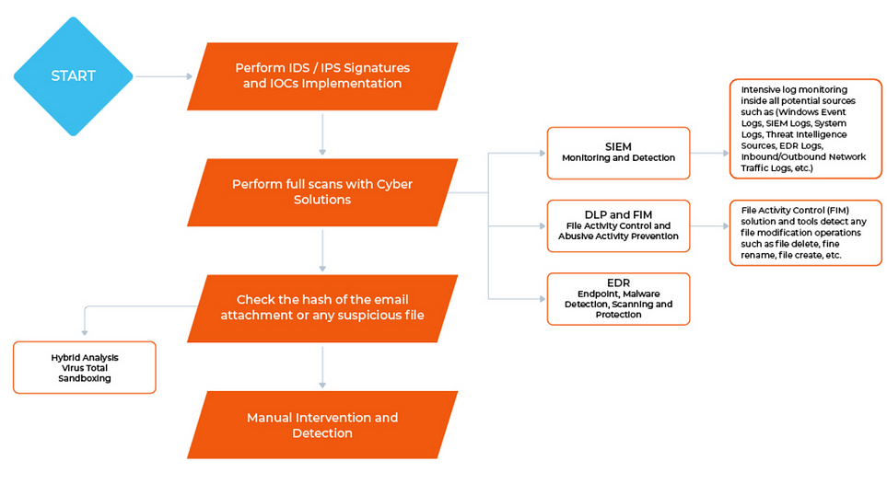
Ransomware Incident Response Playbook – Identification Stage

Slide 18
3. Containment
Objective: Prevent the spread of ransomware within the network
Steps:
Disconnect infected devices from the network.
Implement firewall rules to block communication with malicious IP addresses.
Install EDR files for a comprehensive attack
Tools:
Network Segmentation: Cisco Firepower, Palo Alto Networks
Firewall Solutions: Check Point, Fortinet
EDR: CrowdStrike Falcon, Carbon Black, or Microsoft Defender ATP
HIPPA Regulation: Enforces access control measures

Slide 19
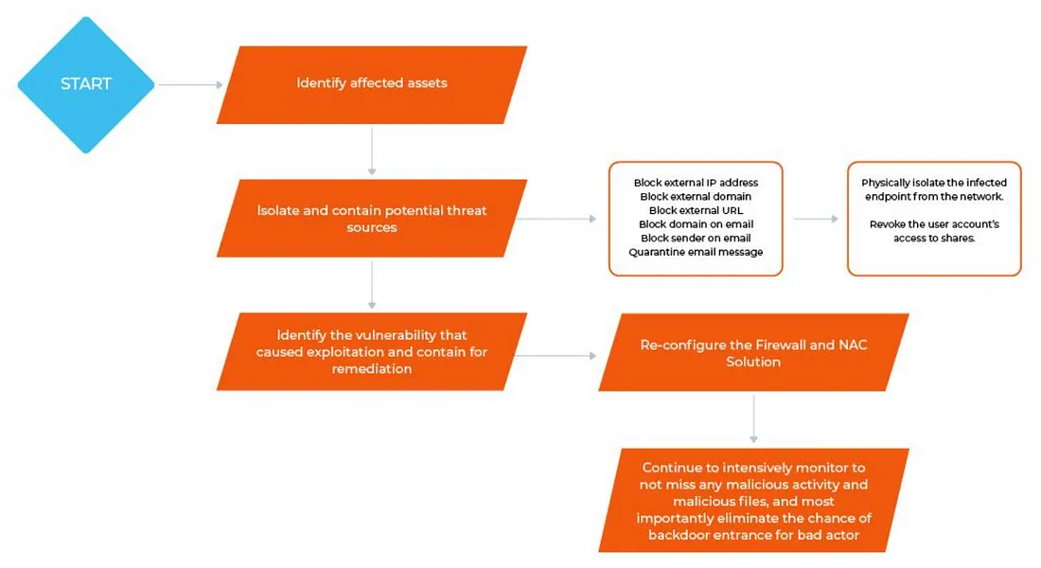
Ransomware Incident Response Playbook – Containment Stage
Objective: Prevent the spread of ransomware within the network
Tools:
Network Segmentation: Cisco Firepower, Palo Alto Networks
Firewall Solutions: Check Point, Fortinet
EDR: CrowdStrike Falcon, Carbon Black, or Microsoft Defender ATP
HIPPA Regulation: Enforces access control measures

Slide 20

4. Eradication
Objective: Completely remove ransomware from affected systems
Steps:
Use antivirus and anti-malware tools to clean infected systems.
Conduct forensic analysis to determine how the ransomware entered.
Resetting passwords on all accounts especially compromised system
Tools:
Antivirus Software: Bitdefender, Norton
Forensic Tools: EnCase, FTK (Forensic Toolkit
XDR: DLP, TheHive, Magnet Axiom, CrowdStrike Falcon X
HIPAA Regulation: Mandates thorough investigations of security incidents.

Slide 21
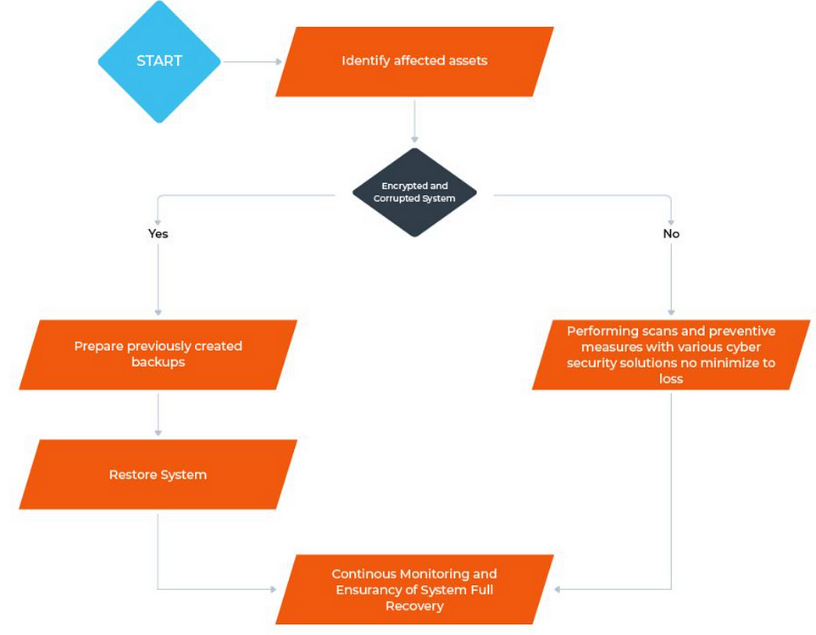
Ransomware Incident Response Playbook – Remediation Stage
Objective: Completely remove ransomware from affected systems
Steps:
Use antivirus and anti-malware tools to clean infected systems.
Conduct forensic analysis to determine how the ransomware entered.
Resetting passwords on all accounts especially compromised system
Tools:
Antivirus Software: Bitdefender, Norton
Forensic Tools: EnCase, FTK (Forensic Toolkit
XDR: DLP, TheHive, Magnet Axiom, CrowdStrike Falcon X

Slide 22
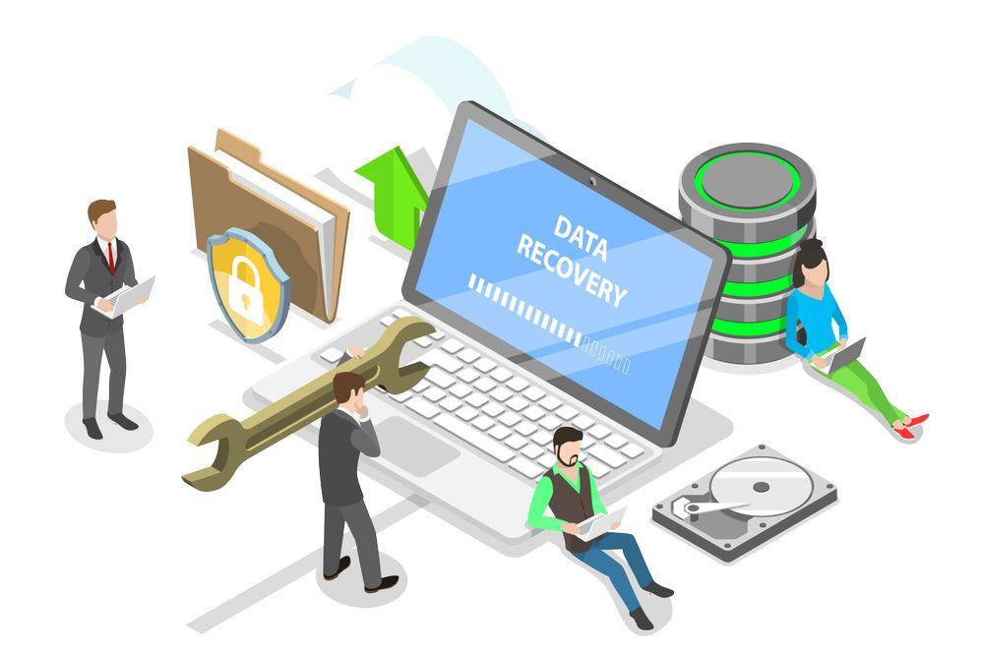
5. Recovery
Objective: Restore normal operations and secure systems
Steps:
Ensure systems are secure and clean use EDR before reconnecting to the network
Use backups to restore patient data.
Tools:
Data Recovery Software: Recuva, EaseUS
Backup Systems: Veeam, Acronis
EDR: IOCs, System Harding
HIPAA Regulation: Requires contingency plans for data recovery

Slide 23
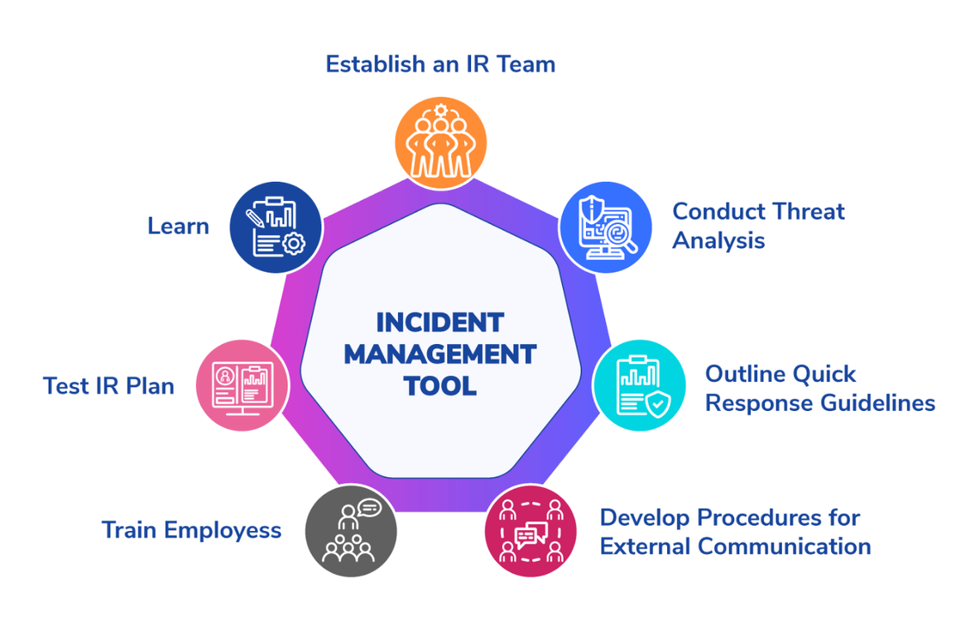
6. Lesson Learned
Objective: Improve future incident response and security posture
Steps:
Conduct a detailed review to identify lessons learned.
Revise incident response plans and security measures based on findings.
Tools:
Incident Management Tools: ServiceNow, Jira
Documentation Tools: Confluence, SharePoint
HIPAA Regulation: Encourages continuous improvement of security measures

Slide 24
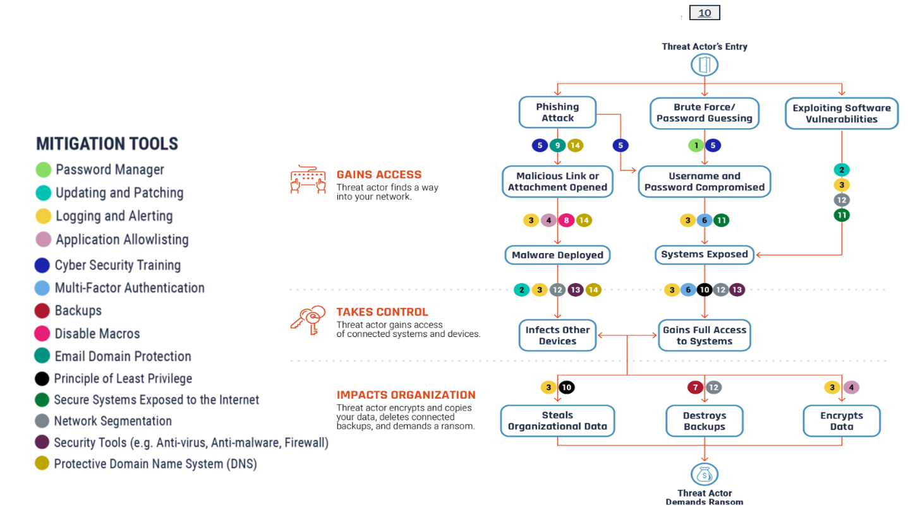
Ransomware Attack
Mitigation
Controls

Slide 25



Conclusion
Ransomware is a significant threat to healthcare organizations, posing risks to patient data and operational continuity.
An effective incident response framework tailored to ransomware can mitigate these risks, ensuring patient data protection and regulatory compliance.
By adopting a comprehensive incident response framework, healthcare organizations can protect patient data, maintain regulatory compliance, and effectively respond to ransomware attacks, ensuring the continuity of critical healthcare services.

Slide 26

Thank You
Any Questions

Slide 27

References
A Strategy for Implementing an Incident Response Plan. Alexandre F. et al
Incident Handler's Handbook, Patrick Kral
Healthcare Security Incident Response Strategy - A Proactive
Incident Response (IR) Procedure. Ying H. et al. https://onlinelibrary.wiley.com/doi/10.1155/2022/2775249
Stickman Cyber https://www.stickmancyber.com/cybersecurity-blog/incident-response-frameworks-nist-sans
Cybersecurity Threats in Healthcare Organizations: Exposing Vulnerabilities in the Healthcare Information Infrastructure https://worldlibraries.dom.edu/index.php/worldlib
Ransomware Attacks on the Healthcare Industry, Dr. William Triplett|

